Slide 1


Cloud For Data Science
Owolabi Adebayo Stephen

Slide 2
Machine learning is inspired by the human brain
Analyzing and discovering patterns in data
, Inc. or its affiliates. All rights reserved.

Slide 3







Data science
is the study of data to extract meaningful insights for business
What happened?
Why did it happen?
What will happen next?
Data science teams convert raw data into meaningful recommendations

Slide 4
Machine learning lifecycle
Fetch
Monitor
Clean
Deploy
Prepare
Evaluate
Train

Slide 5

Challenges in Data Science
Data analysis and preparation is time consuming
So many tools
Highly iterative processes
Lots of manual effort
Quickly evolving as a discipline

Slide 6

Amazon SageMaker
Purpose-built tools so you can be 10x more productive
Amazon SageMaker Studio notebooks
Access ML data Connect to many data sources such as Amazon Simple
Prepare data Transform data to browse data sources, explore metadata,
Build ML models Optimized with 150+ popular open- source models and
Train and tune ML model
Correct performance problems in real time
Deploy and monitor results Create, automate, and manage end-to-
Storage Service(S3), Apache Spark, Amazon Redshift, CSV files, and more
schemas, and write queries in popular languages
frameworks such as TensorFlow and PyTorch
end ML workflows
to improve model quality

Slide 7
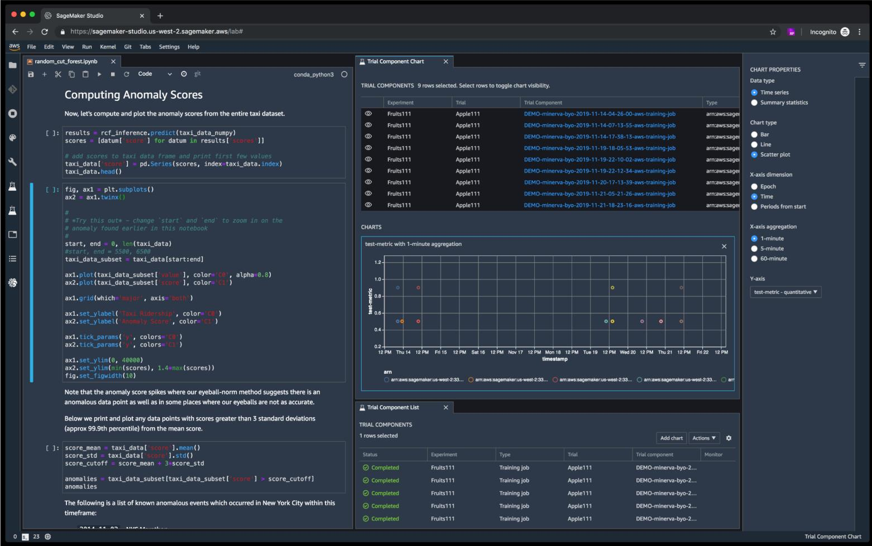
Amazon SageMaker Studio
The first fully-integrated IDE for Machine Learning
Integrated tooling to author code, track experiments, perform debugging, execute and monitor pipelines, setup ML projects, etc.
Onboard with either AWS Single Sign-On (AWS SSO) or AWS Identity and Access Management (IAM) for authentication
Supports VPC-only configuration for private networking configuration
Flexible and scalable Jupyter notebooks

Slide 8
Amazon SageMaker overview
Amazon SageMaker
PREPARE
SageMaker Ground Truth Label training data for machine learning
SageMaker Ground Truth Plus Label training data for machine learning
SageMaker Data Wrangler Aggregate and prepare data for machine learning
SageMaker Processing
Built-in Python, BYO R/Spark
SageMaker Feature Store
Store, update, retrieve, and share
features
SageMaker Clarify
Detect bias and understand model predictions
BUILD
SageMaker Studio Notebooks
Jupyter notebooks with elastic compute and sharing
Built-in and Bring your-own Algorithms
Dozens of optimized algorithms or bring
your own
Local Mode
Test and prototype on your local machine
SageMaker Autopilot
Automatically create machine learning models with full visibility
TRAIN & TUNE
Managed Training
Distributed infrastructure management
SageMaker Experiments
Capture, organize, and compare every step
Automatic
Model Tuning
Hyperparameter optimization
Distributed Training Libraries
Training for large datasets and models
SageMaker Debugger
Debug and profile training runs
Managed Spot Training
Reduce training cost by 90%
DEPLOY & MANAGE
Managed Deployment
Fully managed, ultra low latency, high throughput
Kubernetes & Kubeflow Integration
Simplify Kubernetes-based machine learning
Multi-Model Endpoints
Reduce cost by hosting multiple models per instance
SageMaker Model Monitor
Maintain accuracy of deployed models
SageMaker Edge Manager
Manage and monitor models on edge devices
SageMaker Pipelines
Workflow orchestration and automation
SageMaker JumpStart
Pre-built solutions for common use cases
SageMaker Studio
Integrated development environment (IDE) for ML

Slide 9
Data Preparation phase
Fetch
Monitor
Clean
Deploy
Prepare
Evaluate
Train

Slide 10






Amazon SageMaker Processing
Elastic Container Registry
FRAMEWORK CONTAINERS
Fully managed
Fully managed single-node or distributed data
processing using ephemeral clusters
BYO CONTAINER
VPC
Built-in containers or bring your own
Amazon SageMaker Processing
Security and compliance
Leverage Sagemaker’s security and compliance
(VPC, encryption, etc.)
ML Compute
ML Compute
Instance
Instance
…
Amazon S3
Amazon S3
Processing Code
Processing Code
Dataset Definition (Athena/Redshift)
Amazon SageMaker Feature Store
ML Storage
ML Storage

Slide 11
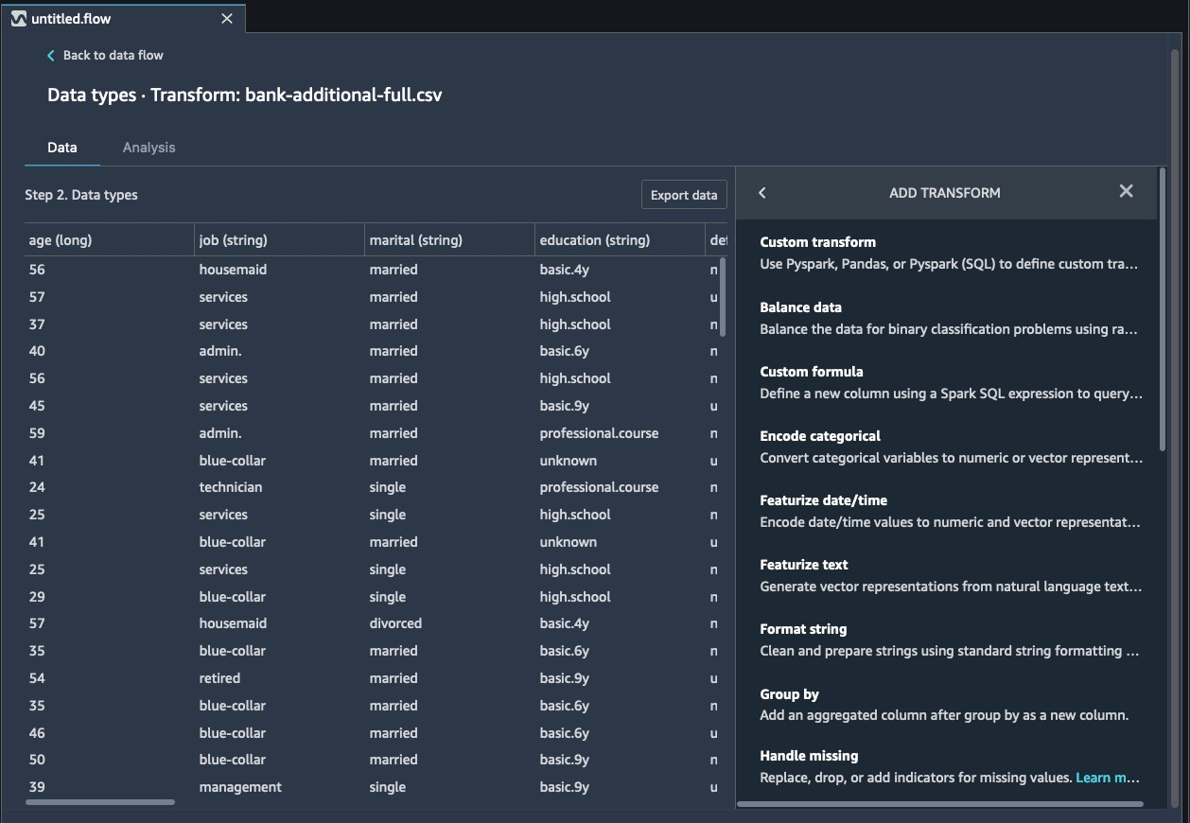
Amazon SageMaker Data Wrangler
Single visual interface for common data prep techniques
Select data from multiple sources
300+ built-in transformations

Slide 12
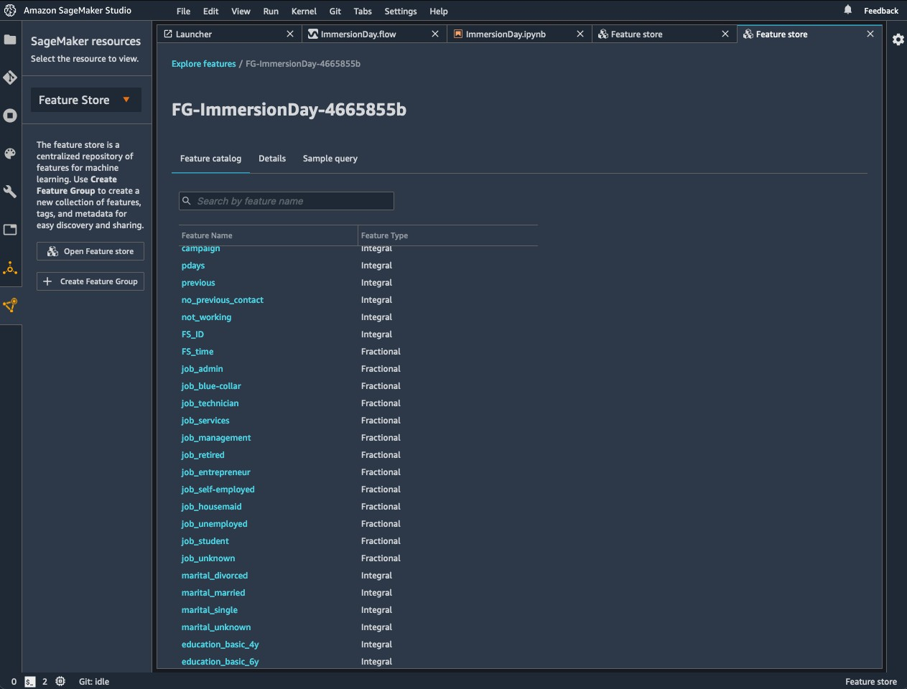
Amazon SageMaker Feature Store
Online and offline
Millisecond latency
Consistent features
Batch and streaming ingestion
Feature discovery and reuse

Slide 13
Train and tune models
Fetch
Monitor
Clean
Deploy
Prepare
Evaluate
Train

Slide 14
2
Many Ways to Train Models on Amazon SageMaker
1
Built-in Algorithms
3
BYOC
Script Mode

Slide 15





Amazon SageMaker Training
Elastic Container Registry
MARKETPLACE CONTAINERS
ALGORITHM CONTAINERS
FRAMEWORK CONTAINERS
BYO CONTAINER
Fully managed
Fully managed single-node or distributed training using ephemeral clusters
Built-in algorithms, built-in, marketplace or bring your own containers
VPC
Managed Spot Training
Save up to 90% in model training compared to on- demand instances
Amazon SageMaker Training
ML Compute Instance
ML Compute Instance
Security and compliance
Leverage Sagemaker’s security and compliance (VPC,
encryption, etc.)
Amazon S3
Training Code
Training Code
…
Amazon EFS
Model archive in Amazon S3
Amazon FSx for Lustre
ML Storage
ML Storage

Slide 16
Deploy models
Fetch
Monitor
Clean
Deploy
Prepare
Evaluate
Train

Slide 17


Amazon SageMaker Hosting
Elastic Container Registry
MARKETPLACE CONTAINERS ALGORITHM CONTAINERS FRAMEWORK CONTAINERS
Single-digit millisecond overhead latency For use cases requiring real-time responses
Built-in algorithms, built-in, marketplace or bring
your own containers
With the most popular serving stacks
BYO CONTAINER
VPC
Client Application
Amazon SageMaker Hosting
Asynchronous inference
Supports large models with long-running processing times
HTTPS
Endpoint
Cost-effective deployment options
Multi-model/multi-container endpoints, serverless inference, and elastic scaling
ML Compute Instance
ML Compute Instance
Model serving &
Model serving &
…
A/B Testing
Use production variants to automatically distribute
traffic
Model archive in Amazon S3
Inference Code
Inference Code
ML Storage
ML Storage

Slide 18
Monitor models
Fetch
Monitor
Clean
Deploy
Prepare
Evaluate
Train

Slide 19







SageMaker Model Monitor
Detect divergence in data
Detect quality degradation over time
Track model balance
Feature attribution

